Slide 1
Software System Design
EE493
Joesphan Lu

Slide 2
Summary
Microcontroller Responsibilities
Insulin temperature regulation
Measuring temperature
Controlling peltiers
Datalogging insulin temperature
Battery management system
Battery balancing
BLE communication
Transmission of data and battery status

Slide 3
Summary (cont’d)
App Responsibilities
UX – present the user with data
Battery status
Insulin temperature
Realtime and historic

Slide 4
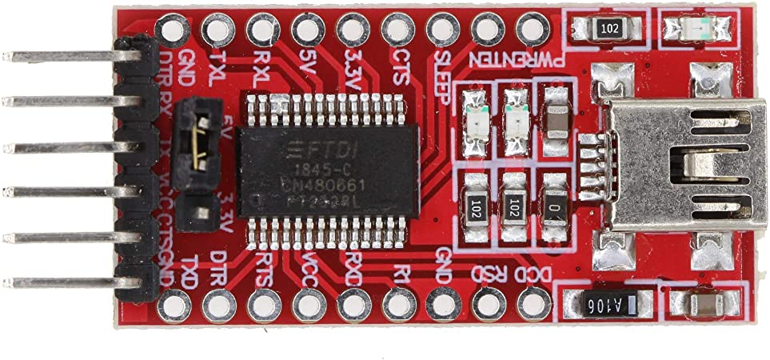
Tools
VsCode
ESP-IDF SDK for coding, debugging, and flashing
Gitlab
Github desktop for version control frontend
USB to UART converter
FT232RL, CH340G or similar

Slide 5
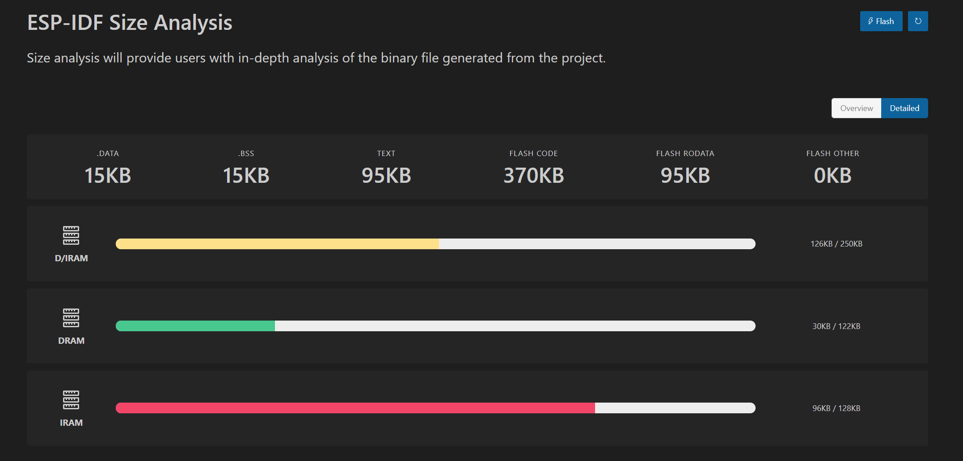
MCU Resources

Slide 6
Kernel and Task/ISR Design
freeRTOS
BLE SDKs provided by EspressIf use it
BLE is the biggest software hurdle
ISRs:
Insulin temperature regulation timer
Control peltier coolers on an interval
BLE device connection detection
Start BLE data transmission
USB availability detection
Run battery balancing

Slide 7
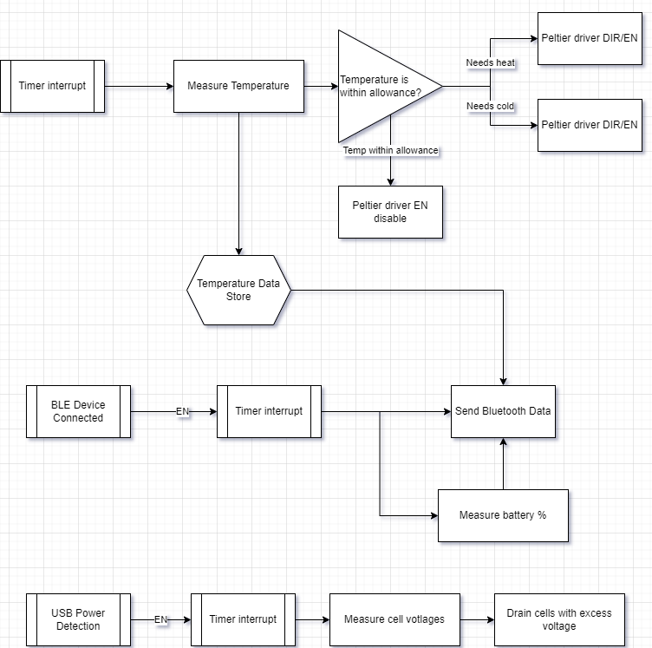
Flow-Diagram

Slide 8
Module/Library Description
TemperatureController
Managing temperature of insulin, peltier control
BatteryMonitor
Battery balancing
Reads battery percentage
Datalog
Records temperature of insulin to be sent via BLE
BLESend
Send datalogged data to user’s phone

